Slide 1
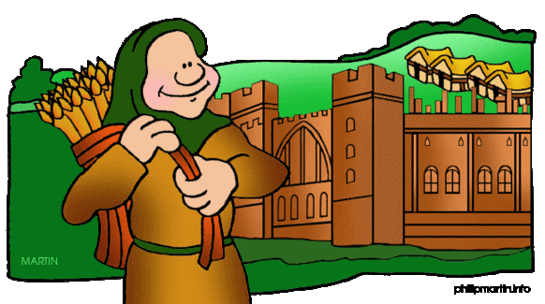
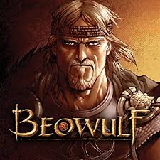
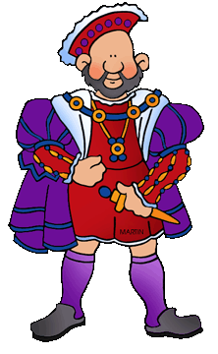
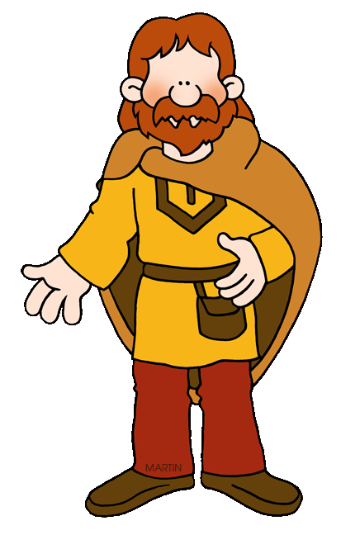
As mathematicians we will be working on place value and addition and subtraction.
Year 5
Autumn 1 topic:
Were the Anglo Saxons really smashing?
As historians we will be investigating the impact that the Anglo Saxons had upon life in England from their arrival to The Battle of Hastings.
As readers we will investigate texts about the Anglo Saxons and Alfred the Great. We will read and discuss how the Saxons brought law and order to Britain. We will use our class novels to extend our knowledge of the Anglos and Saxons.
As geographers we will investigate where the Anglos and the Saxons came from and look at Saxon settlements.
The significant people we will be researching this half term are:
Edward the Confessor and St Bede
Adrian of Canterbury
Class novel: Beowulf M. Morpurgo.
As religious scholars, we will be looking at some writings from the Torah, Buddha and Guru Granth Sahib.
As computer programmers we will begin to study: speed, direction and coordinates.
When staying safe online we will be recognising acceptable and unacceptable behaviour and identifying a range of ways to report concerns about content and contact.
As scientists, we will investigate animals and humans.
As writers we will be writing the science fiction narrative ‘Cosmic’ and we will be studying and recreating the poem, ‘The Highway Man’.
As artists and designers we will be investigating Anglo Saxon art and making sculpted dragon/monster eyes. We will also be creating local landscapes.
As musicians we will be learning to play Samba instruments.
As language learners we will be studying how to fluently describes ourselves in French.
In PSHCE we will studying ‘Me and My Relationships’.
As athletes we will be working on dance and gymnastics.
For Enrichment this half term we will be experiencing an Anglo Saxon banquet.
In Fundamental British Values we will be looking at how we respect others and ourselves.

