Slide 1
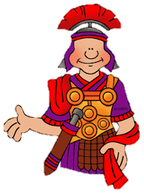
As mathematicians we will deepen our understanding of place value and develop more formal methods for written addition and subtraction.
As historians we will be investigating the Roman empire and what they brought to Britain.
As writers we will use Charlie and the Chocolate Factory as a model for our writing. We will also learn the skills needed to write a newspaper report.
Why were the Romans so powerful?
In PSHCE we will learn about democracy.
As language speakers we will be developing our
knowledge and understanding of French vocabulary.
In Religious Education we will look at the stories of three religions studied so far.
In Music we will start to learn how to play the trumpet!
As artists we will learn how to draw portraits.
As Scientists we will be learning about the three states of matter. We will investigate the melting point of chocolate and find out about the water cycle.
As computer programmers we will learn how to use algorithms to create a Roman mosaic.
In Physical Education we will be developing our football skills .

